Slide 1
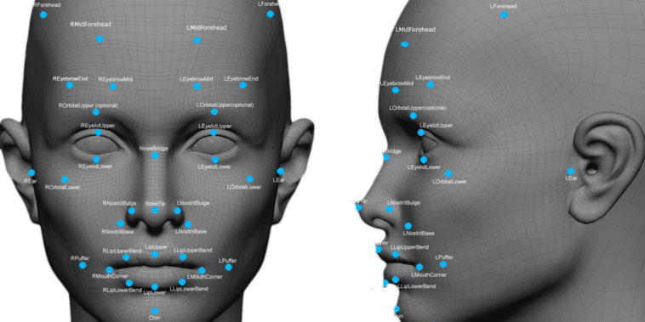
FACE DETECTION
This Photo by Unknown Author is licensed under CC BY-NC

Slide 2
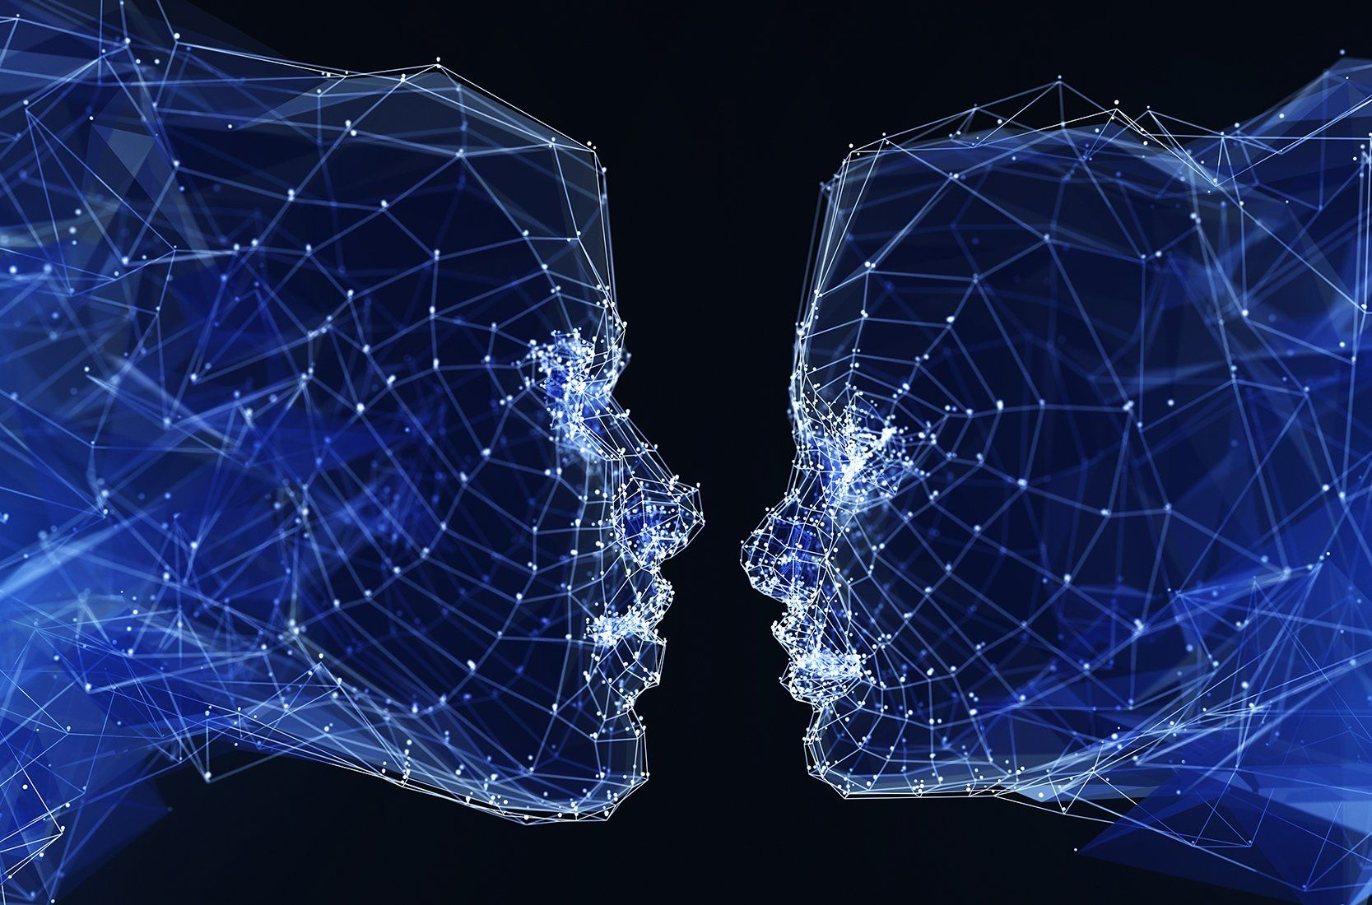
What Is Face Detection ?
Face detection is an area of computer vision that focuses on identifying and locating human faces in images or videos.
It’s often the first step in systems like face recognition, emotion detection, or facial tracking.
This Photo by Unknown Author is licensed under CC BY

Slide 3
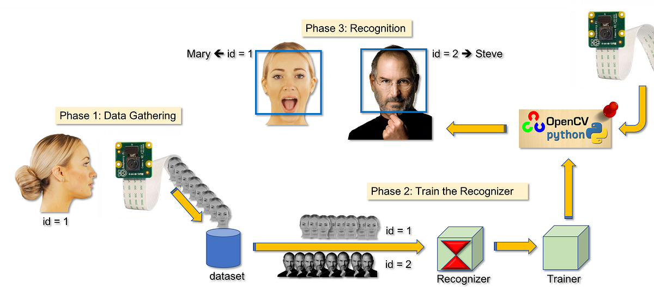
PROJECT OBJECTIVES
To develop a system that automatically detects human faces from images or live video streams.
To understand and implement image processing concepts such as feature extraction, pattern recognition, and classification.
To use machine learning or deep learning algorithms (like Haar Cascade or CNN models).
To draw bounding boxes around detected faces and visually highlight them in real-time or on stored images.

Slide 4
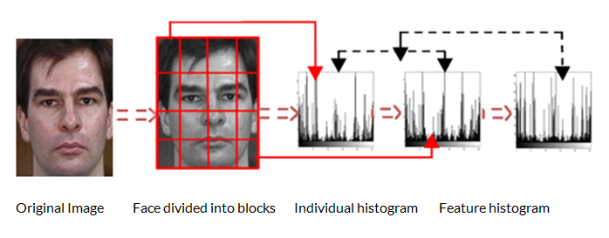
METHODOLOGY
The methodology explains the step-by-step process used to design and develop the face detection system.
It involves collecting images, preprocessing them, applying detection algorithms, and displaying results.
This Photo by Unknown Author is licensed under CC BY

Slide 5
PROBLEM STATEMENT
The goal is to build a system that can automatically detect human faces in images or live video streams.
The system should locate faces and mark them using bounding boxes.
Furthermore, ethical concerns surrounding privacy and consent complicate the deployment of facial detection systems.
Misuse of this technology can lead to surveillance overreach and potential discrimination.

Slide 6
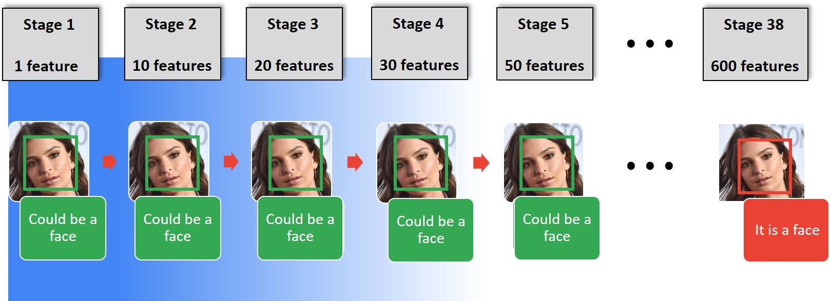
HAAR CASCADE ALGORITHM
The algorithm detects objects (like faces) by learning Haar-like features — simple rectangular patterns that describe how pixel intensity changes in specific regions of the image (like light and dark areas).

Slide 7
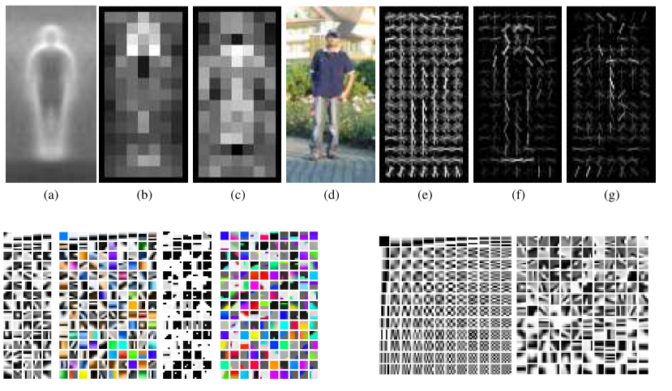
Advantages of haar cascade algorithm
Fast and Real-Time
Pre-trained Models Available Performance
Simple Implementation
Lightweight and Requires Less Memory
Effective for Frontal Faces.
This Photo by Unknown Author is licensed under CC BY-SA-NC

Slide 8
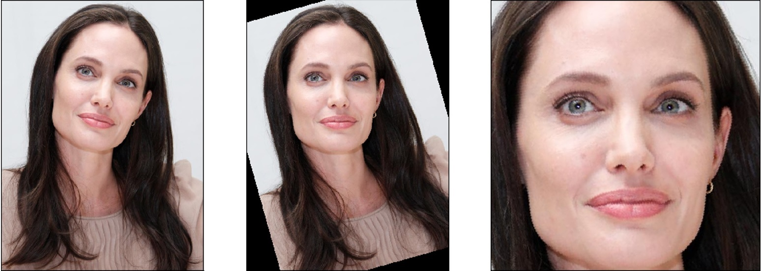
Limitation of haar cascade algorithm
Poor Accuracy with Angled or Side Faces
Sensitive to Lighting and Background
High False Positives
Limited Robustness
Not Suitable for Complex Environments.
This Photo by Unknown Author is licensed under CC BY

Slide 9
IMPLEMENTATION OF FACE DETECTION
Tools and Technologies Used
Component Description Programming Language Python Library used OpenCV (Open Source
computer Vision Library) Algorithm Haar Cascade Classifier Hardware Laptop or PC with webcam Dataset Pre-trained Haar Cascade . XML file

Slide 10
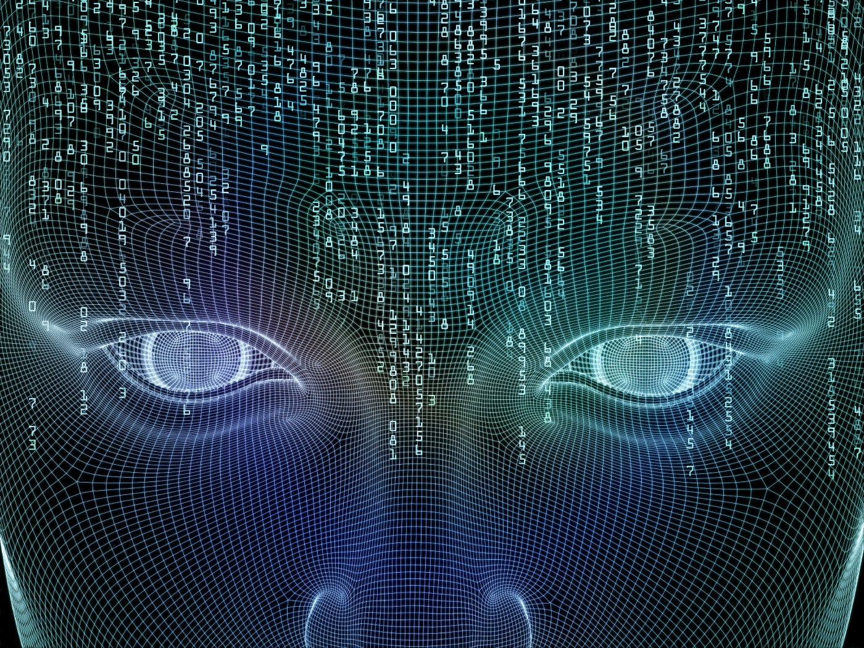
APPLICATION OF FACE DETECTION
Security and Surveillance
Smartphone Authentication
Attendance and Access Control
Human–Computer Interaction
Photography and Social Media
Driver Monitoring Systems
Healthcare and Emotion Analysis
Smart Home and IoT Systems
Entertainment and Media

Slide 11
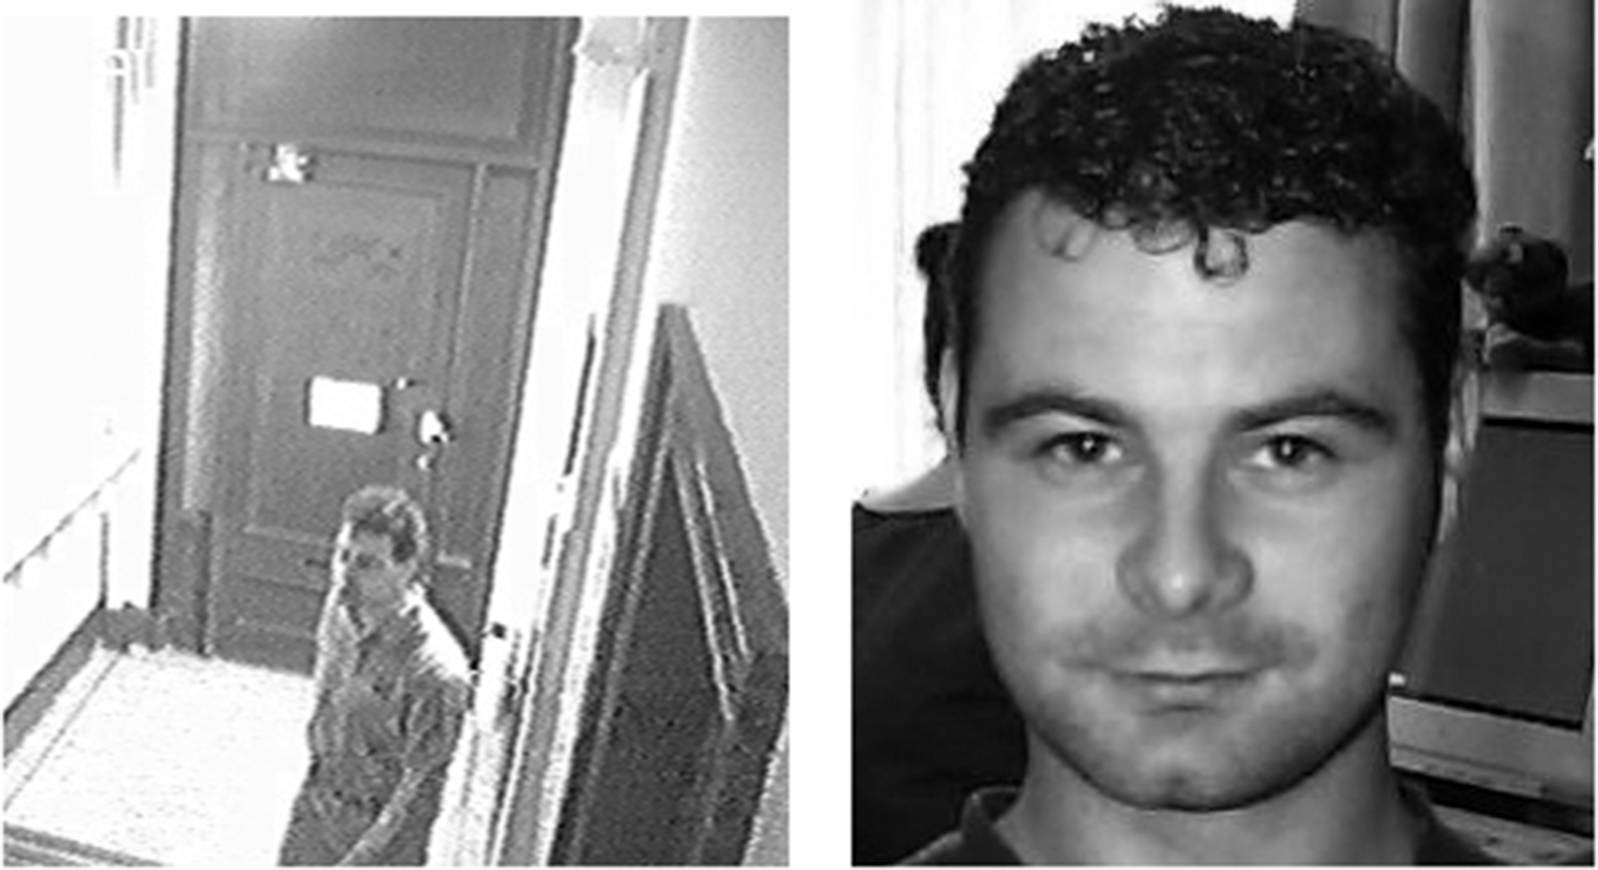
CONCLUSION
The Face Detection Project successfully demonstrates how computer vision and machine learning can be used to automatically detect human faces in images and videos.
By implementing the Haar Cascade Classifier using OpenCV, the system is able to identify faces efficiently and in real time.
Overall, the project shows that face detection is an essential step for various advanced applications such as face recognition, attendance systems, surveillance, and security systems.
It also highlights the potential of artificial intelligence in developing smart and automated systems that can interact intelligently with humans.
This Photo by Unknown Author is licensed under CC BY

Slide 12
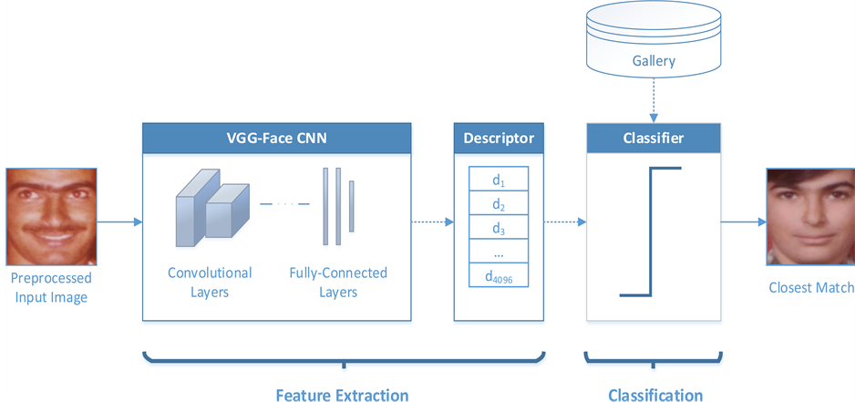
REFERENCE
Digital image processing by Rafel Gonzalez, Richard Woods
Image Processing, analysis and machine vision by Milan Sonka, Vaclav hlavac, Roger Boyle
www.civs.stat.ucla.edu
www.cs.cf.ac.uk
This Photo by Unknown Author is licensed under CC BY

